Slide 1
Rady Children’s Hospital
MSBA 2018 Capstone Project
Derrick Buntin, Feiyang Chen, Linping Yu, Xuehan Zhang, Bihan Zhu

Slide 2
Deliverables
Model
Modified Current Model
Predictive Models of Hourly/Daily Patient Volume
Operation
Bottleneck Analysis

Slide 3
Current Undertaken Model
Daily Prediction Performance
The out-of-sample daily RMSE is 84.55, and MAE is 78.8.
Hourly Prediction Performance
The out-of-sample hourly RMSE is 8.53, and MAE is 6.87.

Slide 4
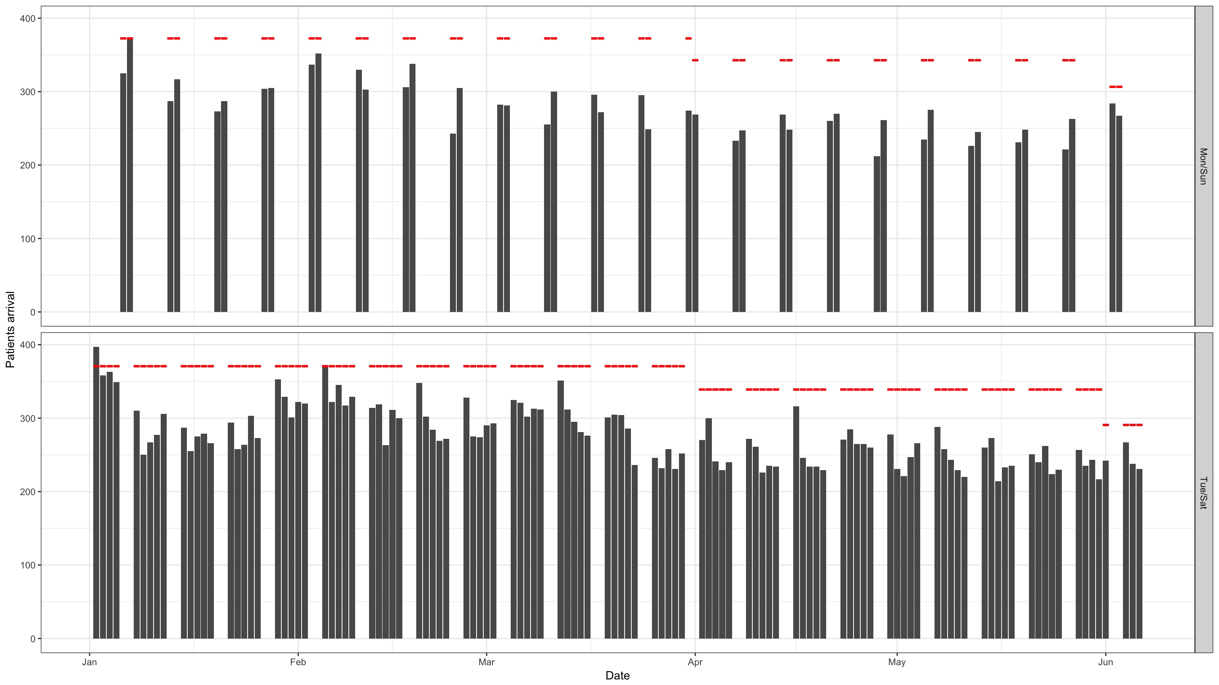
Current Undertaken Model

Slide 5
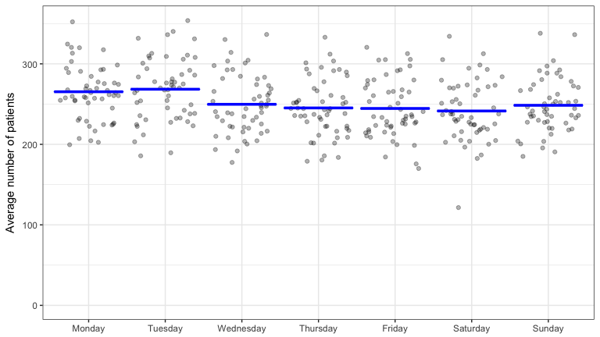
Modified Current Model By Grouping Monday with Tuesday

Slide 6
Modified Current Model By Grouping Monday with Tuesday
Daily Prediction Performance
The out-of-sample daily RMSE is 82.61, and MAE is 77.53.
Hourly Prediction Performance
The out-of-sample hourly RMSE is 8.52, and MAE is 6.87.

Slide 7
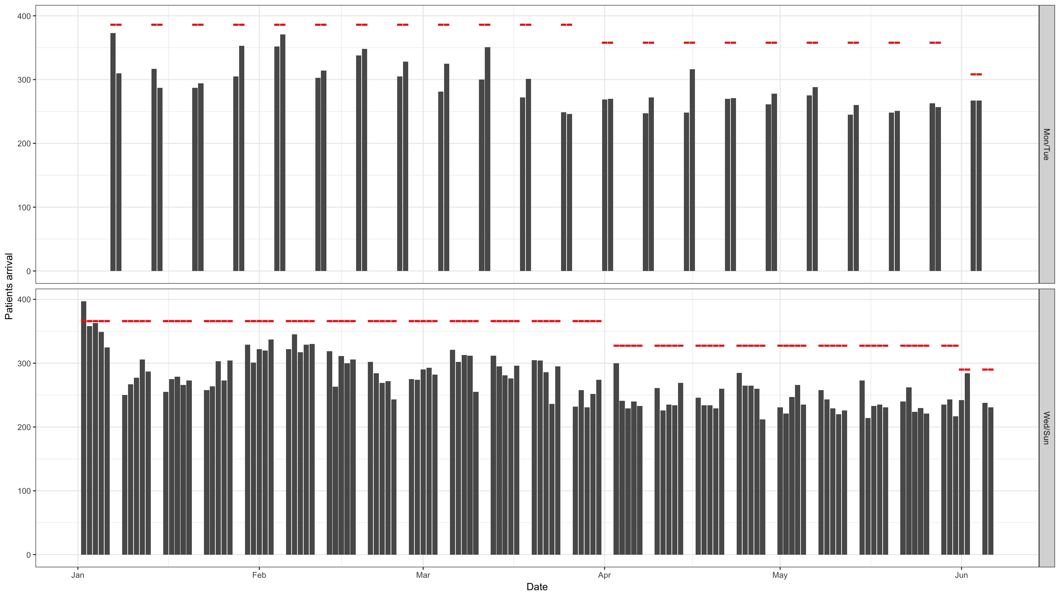
Modified Current Model By Grouping Monday with Tuesday

Slide 8
Daily Patient Volume Linear Model
Data Included:
Weather Data(four months ago): average temperature, average humidity, average wind degrees from north, average wind speed in knots
Flu Data(four months ago): activity level of flu in California and New York
Calendar Date Feature: panic(dummy), weekday, week number, month
Performance: R-square:62.8%

Slide 9
Daily Patient Volume Linear Model
activity_level | -0.103 | 0.011 *
activity_level_ny | 0.078 | 0.010 **
avg_temp | -0.057 | 0.125
avg_relh | 0.069 | 0.008 **
avg_sknt | 0.085 | < .001 ***
avg_vsby | 0.030 | 0.184
panic | -0.017 | 0.401
number | 0.383 | < .001 ***

Slide 10
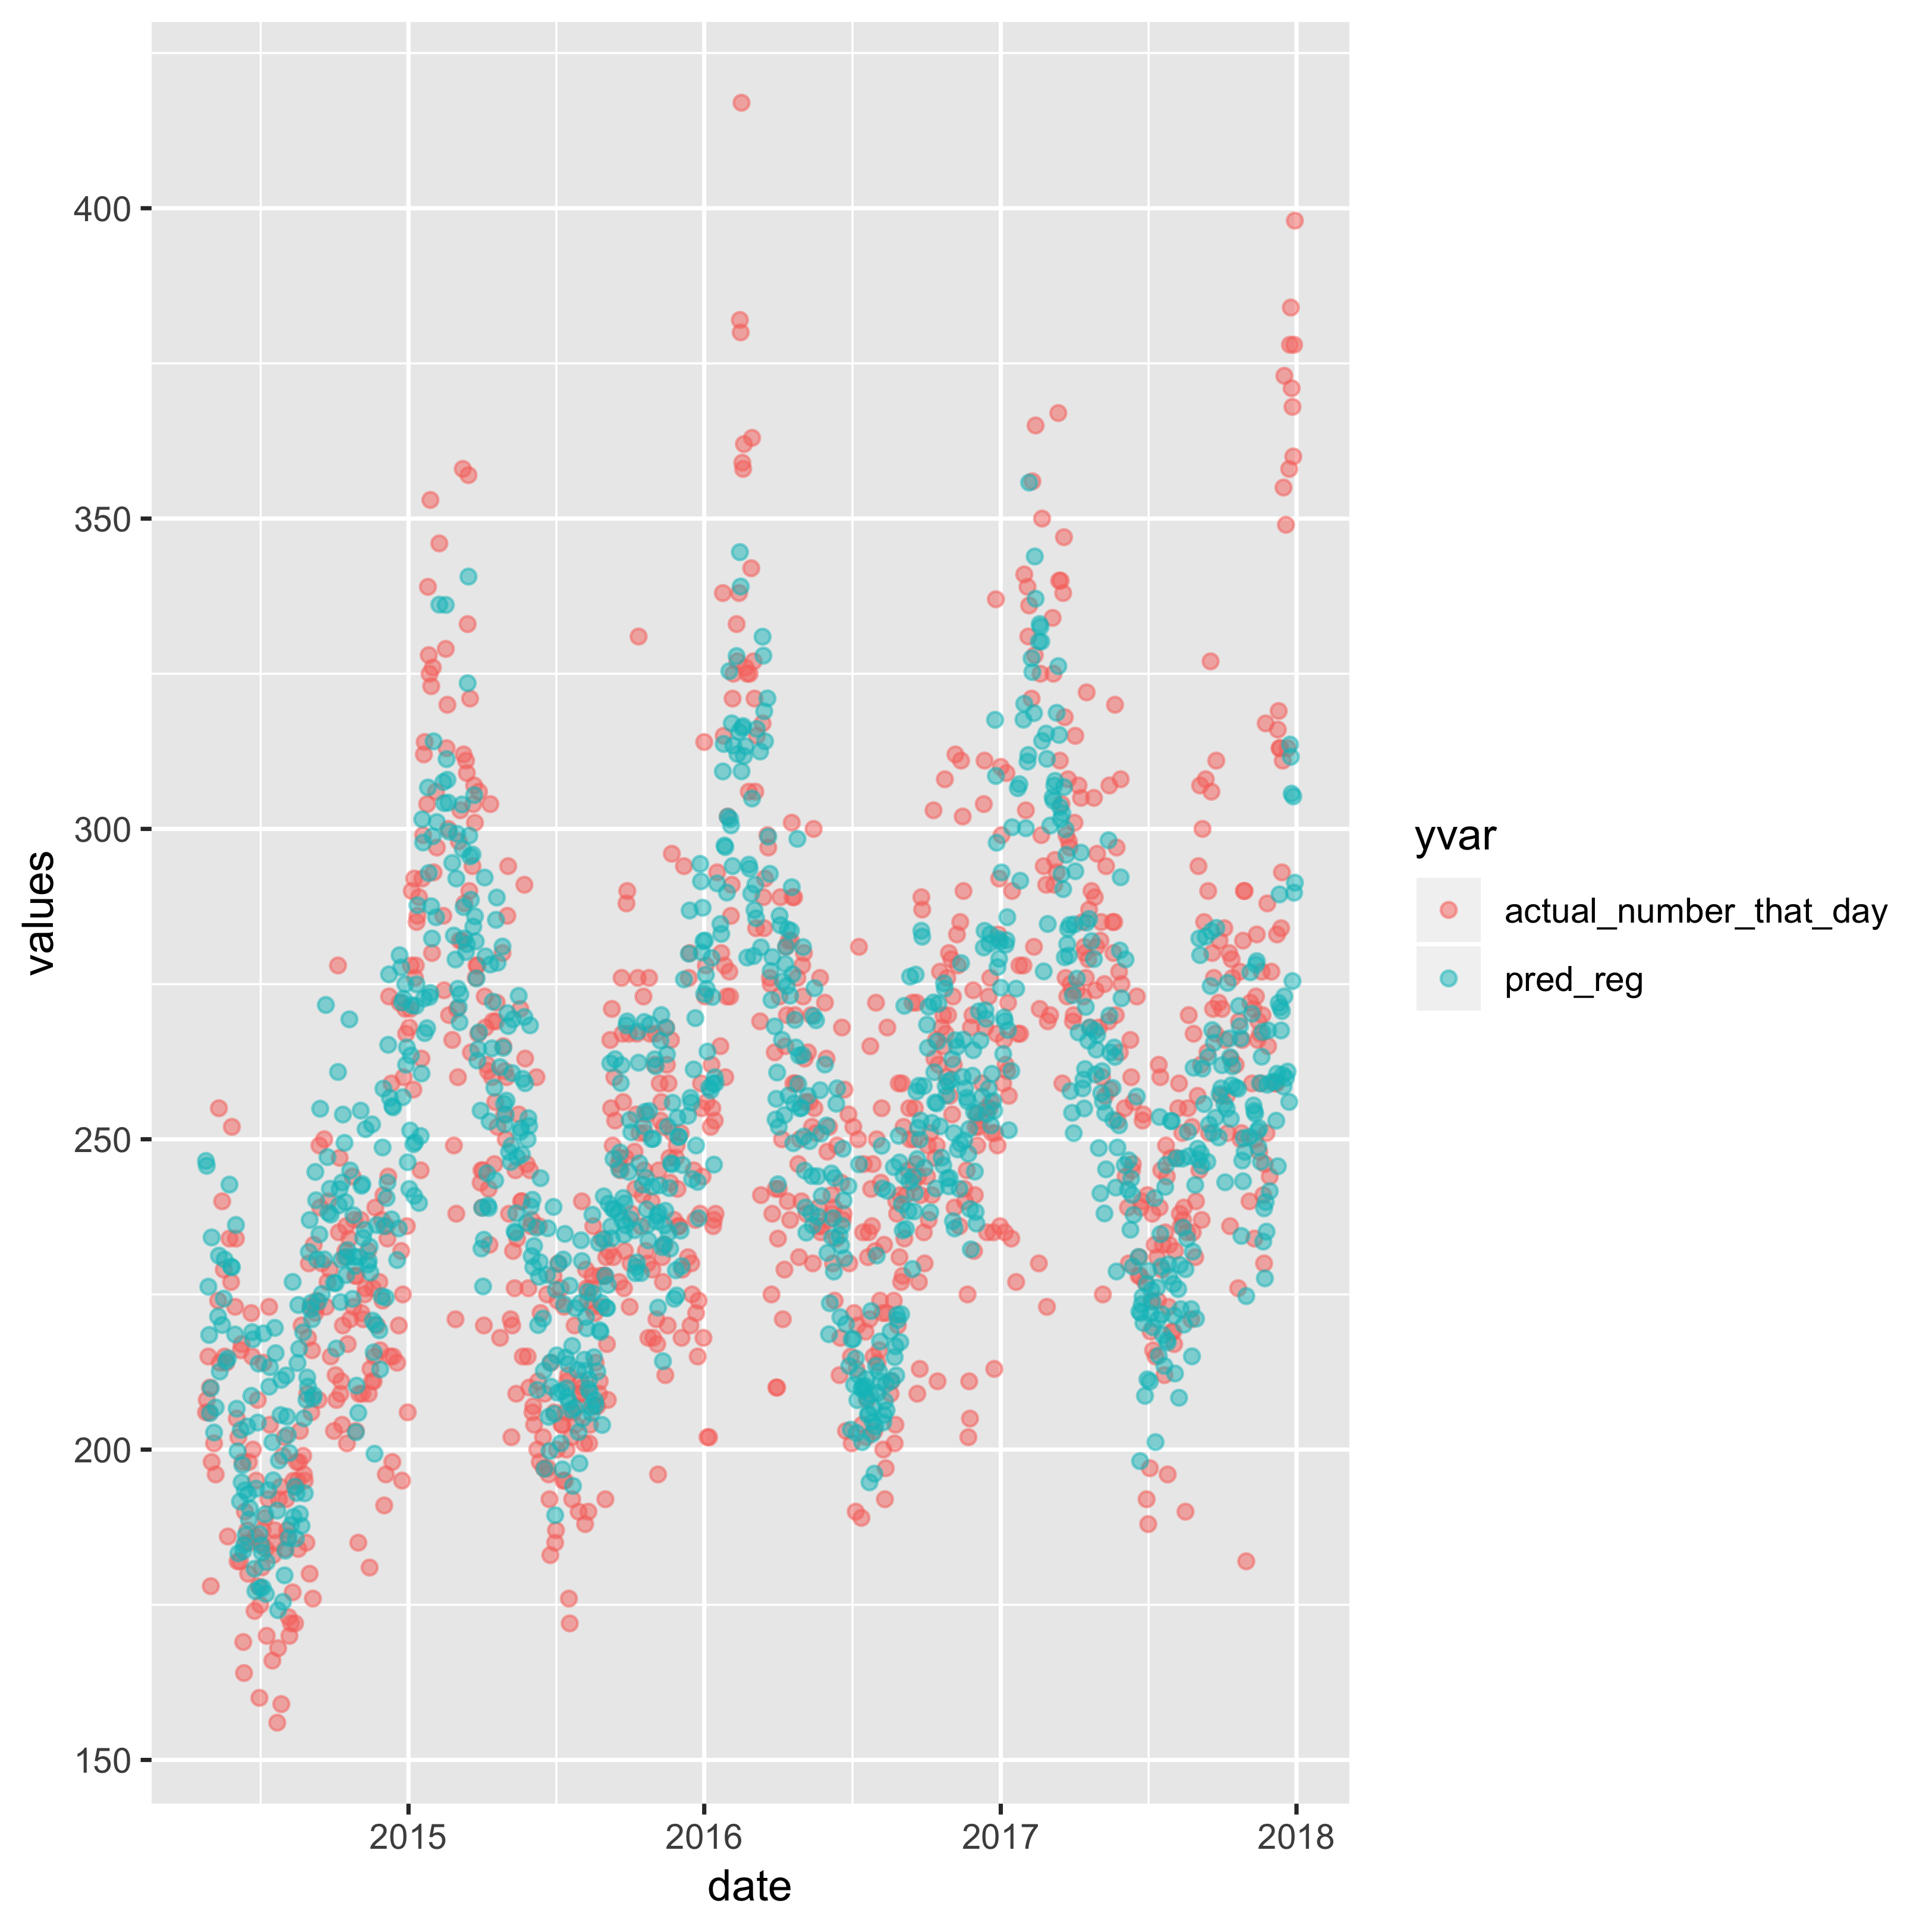
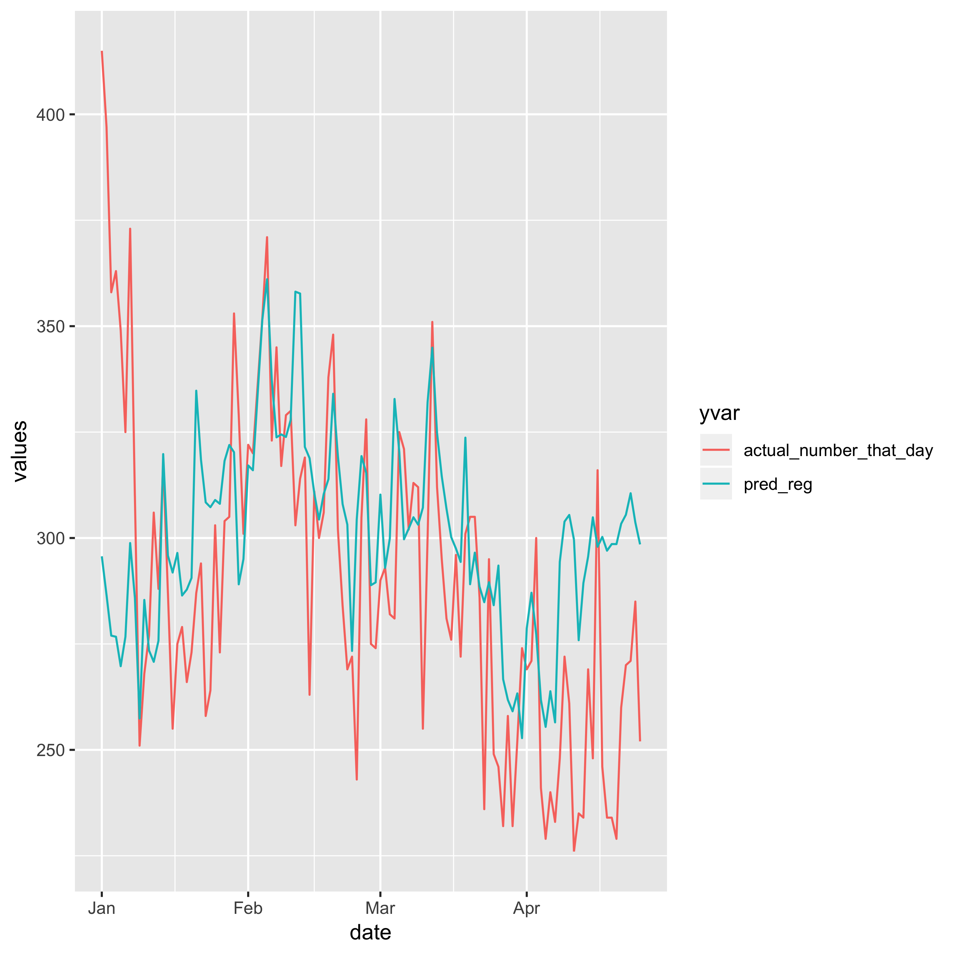
Daily Patient Volume Linear Model
RMSE:
25.49
RMSE:
36
Comparison of train dataset (2014-2017)
Comparison of validation dataset (2018)

Slide 11
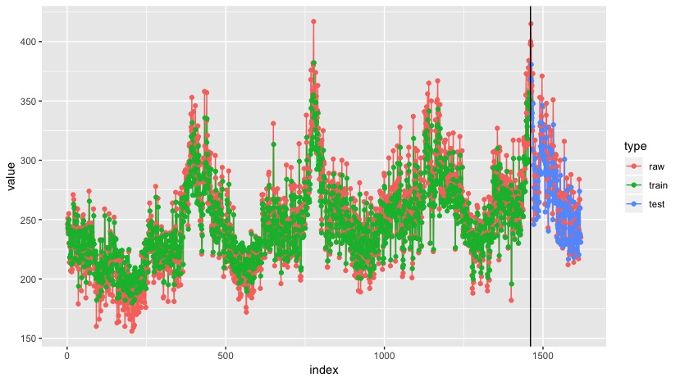
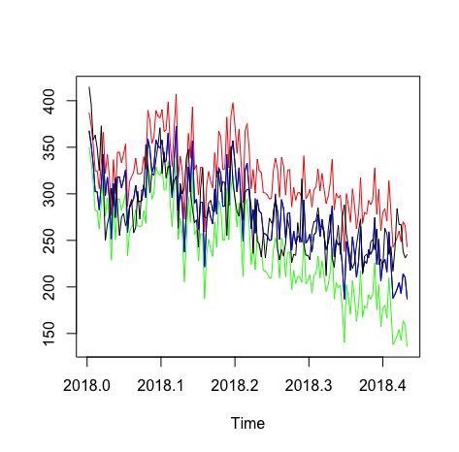
Daily Patient Volume Model
KERAS NN
ARIMA
95% :black
99% : green
80% : red
Actual: blue
Train Score: 621.61 MSE (24.93 RMSE)
Test Score: 689.63 MSE (26.26 RMSE)
RMSE: 33.91

Slide 12
Hourly Patient Volume Linear Model
Data Included:
Predicted Flu Data: total specimens and positive percentage
Calendar Date Feature: weekday, week number, hour
Model Performance:
In Sample RMSE:3.39
Validation RMSE:3.63
R-square: 71.3%

Slide 13
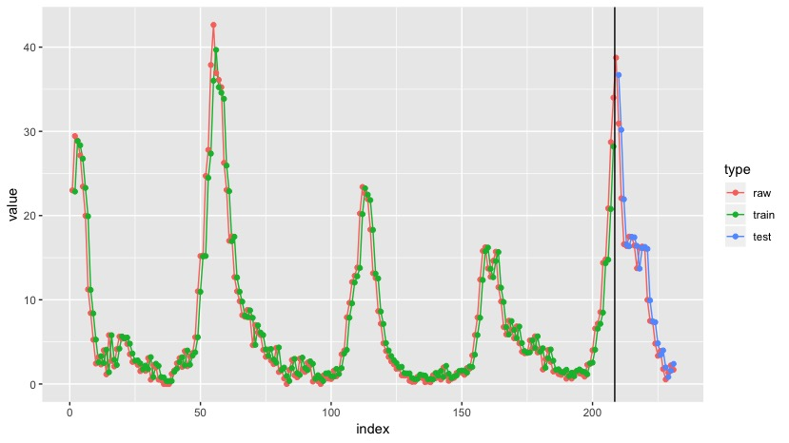
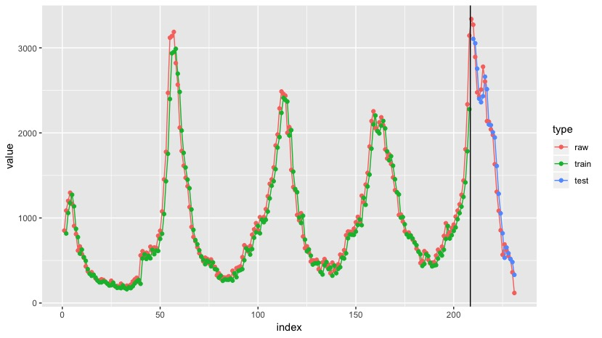
Hourly Patient Volume Linear Model
Positive Percent
Total Specimen
Train Score: 5.92 MSE (2.4349 RMSE)
Test Score: 11.25 MSE (3.3554 RMSE)
Train Score: 26070.12 MSE (161.46 RMSE)
Test Score: 50214.20 MSE (224.08 RMSE)

Slide 14
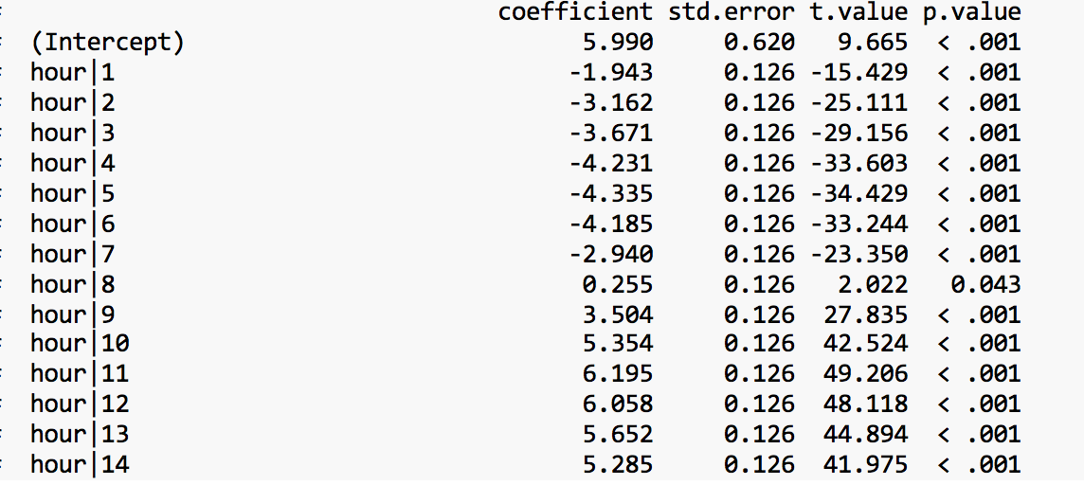
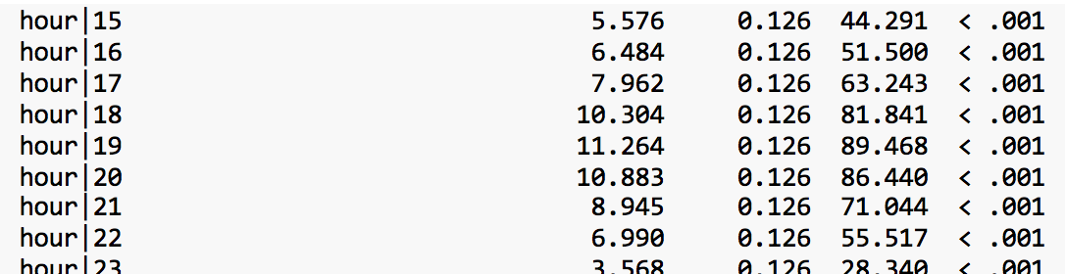
Hourly Patient Volume Linear Model

Slide 15
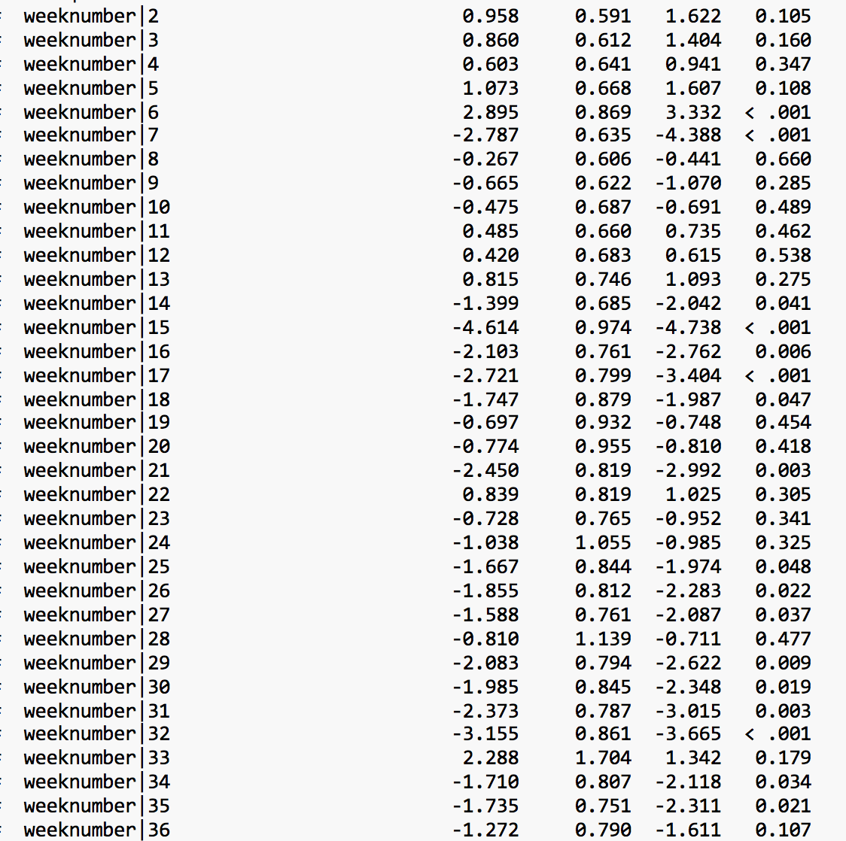
Hourly Patient Volume Linear Model

Slide 16
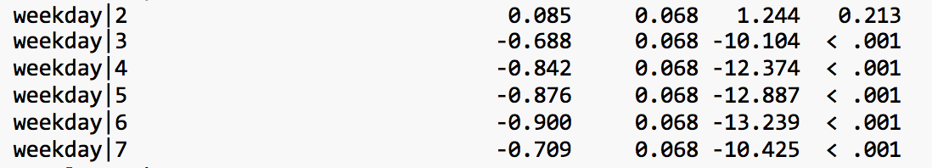
Hourly Patient Volume Linear Model
Total specimens | 0.119
Percent positive | 0.008
Total specimens : percent positive | 0.023

Slide 17
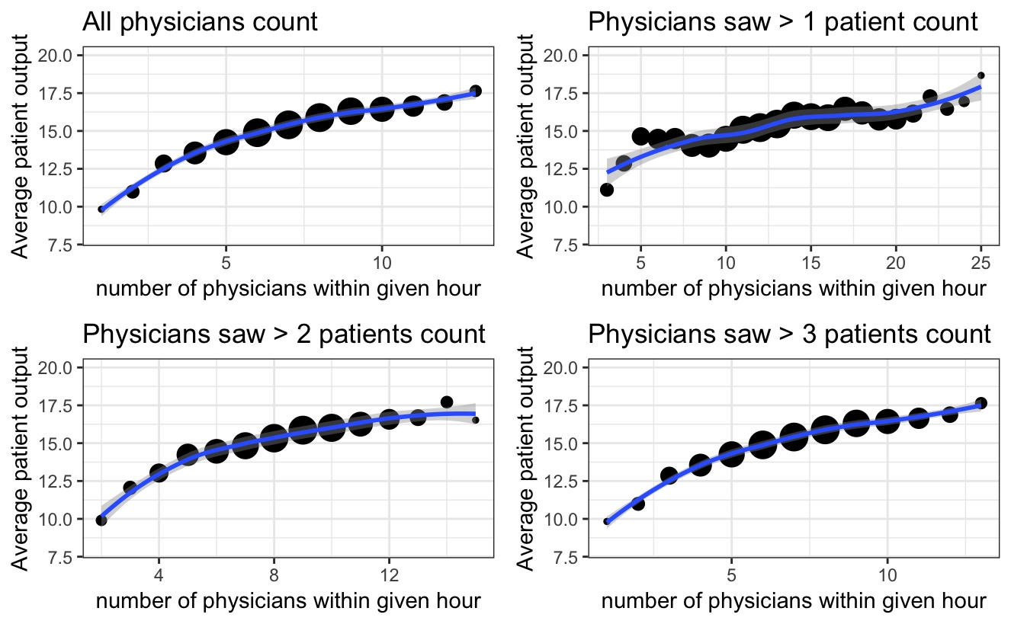
Bottleneck Analysis
Peak Hour Average Patient Output

Slide 18
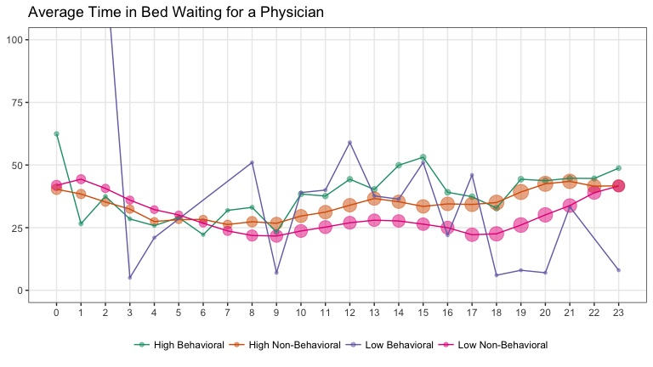
Bottleneck Analysis

Slide 19
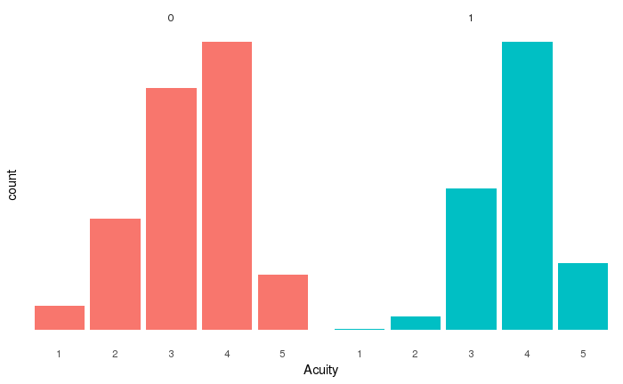
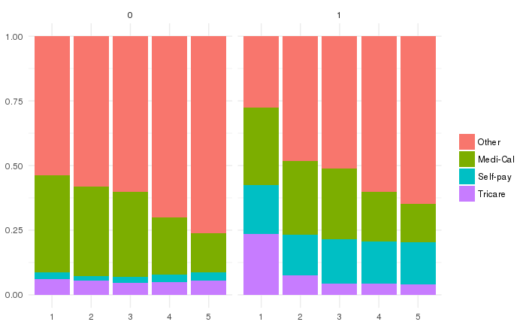
LWBS

Slide 20
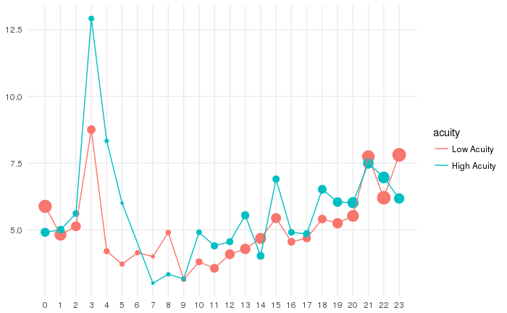
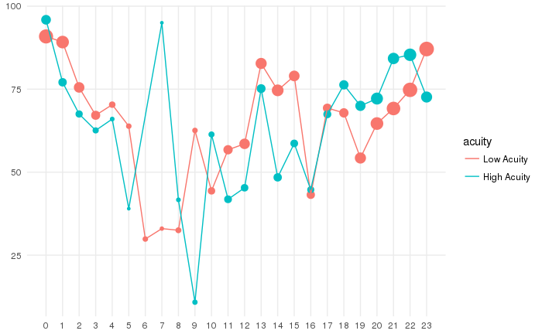
LWBS
Time gap between arrival and triage complete
Time gap between triage complete and roomed in ED

Slide 21
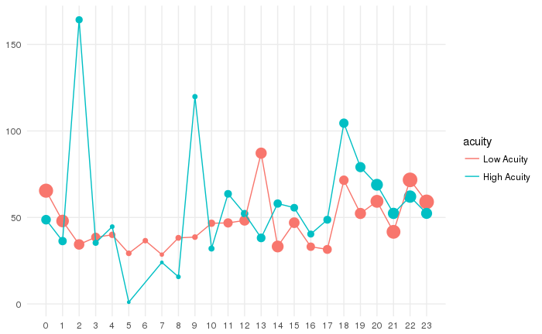
LWBS
Time gap between roomed in ED and departed from ED
Notes:
The three plots shown above revealed that the majority of time a patient labeled with LWBS spent on is waiting to be roomed. Since only 0.2% LWBS patients left before roomed, this was not a huge problem.

Slide 22
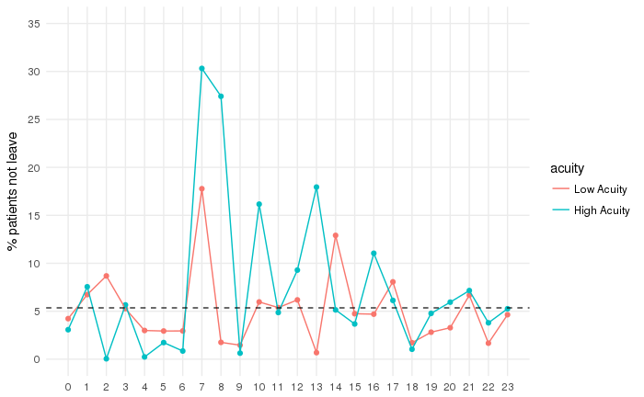
LWBS
Percentage patient (didn’t leave) wait longer than LWBS
Notes:
We assume the time a patient labeled with LWBS left to be the time the physician was assigned. Then we are able to compare the length of two different time gaps.
The time gap between roomed and assigned physician for a patient not labeled with LWBS. For simplicity, we called this type of patients NL patients
The time gap between roomed and left for a patient labeled with LWBS. We called this type of patients L patients.
The black dotted line represents the average percentage that NL patients waited for a physician longer than L patients waited to leave. Only 6% NL patients did not see an actual physician until the average time gap for a L patient to leave after roomed. This implies that, if we could manage to reduce the time gap between roomed and got to see a physician to a certain amount, we can potentially decrease the number of LWBS patients.

Slide 23
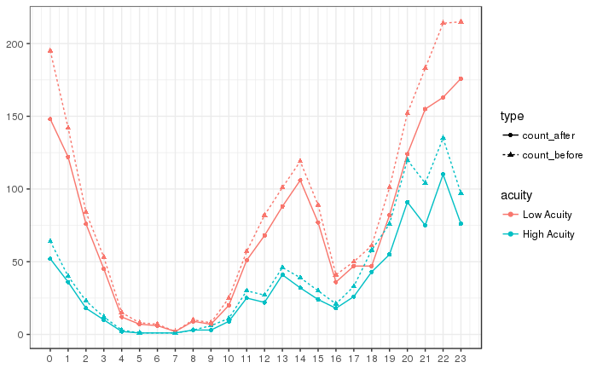
LWBS
Set the threshold to be 90 minutes
LWBS drop 18.27%

Slide 24
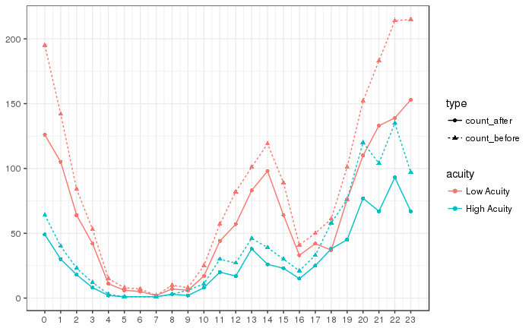
LWBS
Set the threshold to be 60 minutes
LWBS drop 28.76%

Slide 25
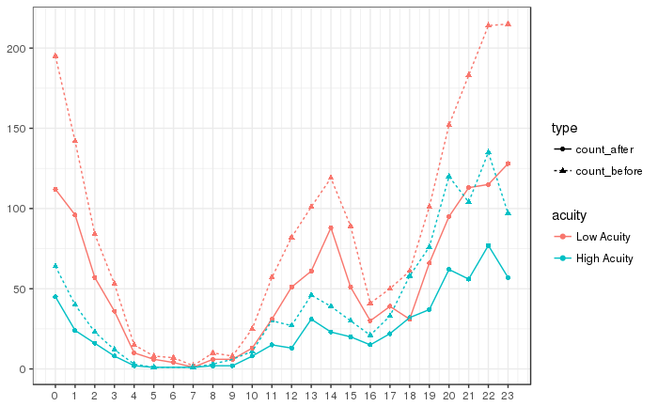
LWBS
Set the threshold to be 40 minutes (average wait time for Non-LWBS)
LWBS drop 39.38%

